Slide 1

Sift Through Search
And Deliver More:
Fine tuning the search experience
Paul Hunt

Slide 2

Who am I?
Paul Hunt
SharePoint Consultant since 2006, Worked in IT & Telecoms since 1988
Working for MS Gold Partner Eurodata, now part of Trinity Expert Systems Group
Blog: www.myfatblog.co.uk
Twitter: @cimares
Notes:
If you’re active on the Internet, Twitter, MSDN or the SugUK Forums, you’ll see my mugshot appearing in a lot of places..
What’s the spread of the room? Developers, IT Pros?

Slide 3





Fine tuning search
Versions?
+
Notes:
Versions that we can use with these techniques
Foundation can’t be used, but it can if you install Search Server Express.
Server can be used with Standard or Enterprise
And of course FAST.
SharePoint 2013 – Foundation, Standard and Enterprise all get the full FAST style search application
Foundation has some configuration limitations, restricting it to a single box installation.

Slide 4
Fine tuning search
What aren’t we talking about?
(D * V) * S) +
(10KB * (L + (V * D))) = C
Notes:
What aren’t we talking about today..
We’re not talking about how you should architect your environment
Or how you should size it

Slide 5





Quick Poll
What’s the first thing you do when you want to find something on the Internet?
Notes:
The vast majority of internet users will go to a search engine as their first port of call when looking for information on the Net.
Room test: Raise all hands, then lower yours if your favourite search engine appears.
The big 5, that (almost) everyone uses.
If another one.. Why? Illustrates the point that users have a go to search engine

Slide 6

Quick Poll 2
What’s the first thing an average End User does when they want to find something internally?
Notes:
The majority of end users will BROWSE because they THINK they know where to find stuff. Invariably they waste time searching manually. Great way to waste an afternoon, browsing the library
So why do we care and what can we do about it?
Efficiency and productivity are improved when Users can find the information they need to do their job.
So, the best thing we can do is install SharePoint Search and everything’s Dandy?

Slide 7
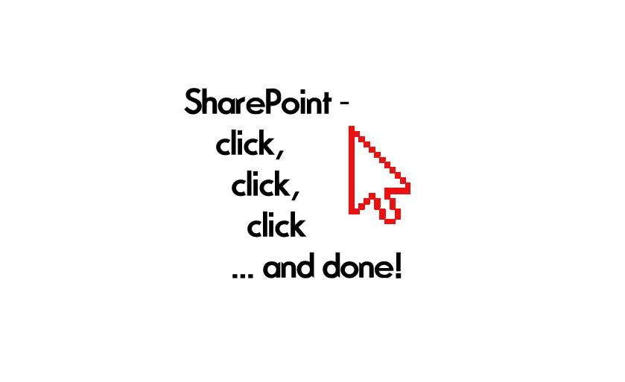
But I’ve installed SharePoint Search!
Surely that’s all I need to do?
© @Naoko_Strega
Notes:
So, the best thing we can do is install SharePoint Search and everything’s Dandy?

Slide 8
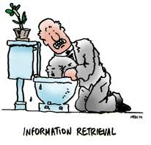
Fine tuning search – Why?
IDC Research in 2007
  On average 1 information worker will waste up to 3.5 hours a week on searches that don’t result in anything
Notes:
IDC Research – 2007 – On average 1 information worker will waste up to 3.5 hours a week on searches that don’t result in anything.
One of thing things that I’ve always told my clients is that Searching isn’t enough. FINDING is the important part. The man in the picture has just dropped his wedding ring, That’s the one result he’s interested in finding. Everything else is superfluous..
In the context of your users, Returning 1000+ results doesn’t help them. Returning 10 relevant results is much better.
90% of users will not go to the second page of results! Users are generally only interested in the first page. Ask yourself how often you click next page when searching on Bing?

Slide 9




Fine tuning search
Search Components in 2010
Notes:
Crawl component – This is your gatherer, it trawls through your content sources and gathers up the information. Think of a baby crawling around the living room, pulling everything into a big heap in the middle.
Index component – This is the structured data that comes from the crawl. In SharePoint search, these two functions are combined into one. In our scenario, it’s the parent, sorting through the mess left by the baby and putting a sense of order to it.
Query component – This does the hard work of generating results from User queries. This is also where linguistic processing is done, Word breakers, thesaurus files etc.
Index partition… Assist with scaling search, Written to by the index component and used by the query engine

Slide 10
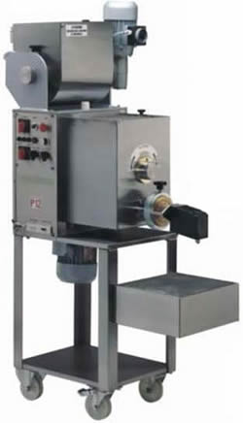


Fine tuning search
Search Components in 2013
Notes:
These exist in 2013 albeit with some changed names, along with some additional components
Crawl component – remains named the same, but splits out the content processing into
Content Processing Component – Processes crawled items and feeds to the Index. iFilters covered here.. (None needed for PDF at last!)
Index Component – This now handles both data being fed into the index, and also processing requests from the….
Query Component – This component now focuses on linguistic processing, word breaking, search stemming, spell checking and thesaurus files.
Analytics Component – Analyses crawled items and how users interact with the site. Helps search learn and provide beter results. (I.e. affects ranking etc)
Search Admin Component – Stores configuration from the UI and handles topology changes.
Search architectures diagrams
http://technet.microsoft.com/en-us/sharepoint/fp123594.aspx
With the move to Fast, SIZING becomes key… These processes are Hungry.

Slide 11

Fine tuning search
Notes:
Where do we start in fine tuning search.
How do we know we need to..
Are we listening to the users?
Are they complaining?

Slide 12

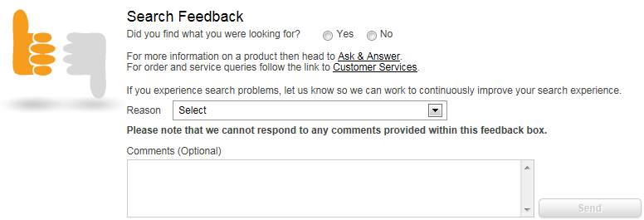
Fine tuning search
If our users are staying silent, how do we know?
Notes:
A good example on the internet is Halfords. When you use their search engine, they display a Search feedback webpart, a great way of prompting feedback on the search experience

Slide 13
Fine tuning search
Search Feedback
DEMO
Notes:
A good example on the internet is Halfords. When you use their search engine, they display a Search feedback webpart, a great way of prompting feedback on the search experience

Slide 14
Fine tuning search – Analytics
Analytics reports
  Number of Queries
    Shows the total number of queries by date.
  Top Queries
    Shows the most popular searches your users perform
  Failed Queries
    Shows where no results were returned
    Shows where low or no click through was performed
  Best Bet Usage
    Shows where your currently configured best bets are working
  Best Bet Suggestions
    Shows you what you could configure as Best Bets
Notes:
Out of the box some basic Search reports are available to you.

Slide 15
Fine tuning search – What Options?
What can we do about it?
  Affect Ranking
    Query Logging/Ranking Models
    Governance
    Authoritative pages
  Scopes (Result Types in 2013)
  Keywords & Best Bets
  Thesaurus entries – Synonyms
  People Search
  Performance

Slide 16
Fine tuning search – Ranking
Everything our users do in Search has the ability to affect ranking if we’re logging.
Devs must use the RecordClick() method in custom code
There are a couple of ways to DIRECTLY affect ranking
  In Query (FAST 2010 & SP2013 only) using XRANK
  Custom Ranking Model using XML
    Can then be used in an extended Core Results web part
Notes:
Note: If you are using custom search solutions, you should implement the RecordClick event either through web service or ObjectModel.
Microsoft Custom Ranking Model Schema - http://msdn.microsoft.com/en-us/library/ee558793.aspx
The Xrank operator allows you to dynamically modify the rank of an item based on an expression.
You can have up to 1000 ranking models per Search tenant in Sp2013, no limit is mentioned for SP2010.

Slide 17
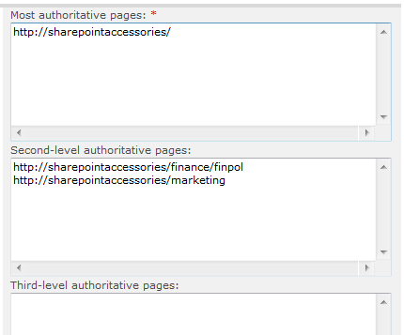


Fine tuning search –Authoritative Pages
Authoritative Pages (Farm Level) :-
The relevance ranking for a search result is determined in part by how far (in clicks) the result is from a URL that is designated as most authoritative
Notes:
Authoritative Pages - http://technet.microsoft.com/en-us/library/cc262796.aspx
Recommended to have 1 top level and minimal second and third level in the Boundaries document (Don’t be fooled by the large entry box!)
Authoritative pages are those that link to the most relevant information. You have a choice of 3 levels of authoritative pages
And also a list for non-authoritative sites which will automatically downrank under any other site. E.g. if you have an archive site, then you would want to down rank pages from this site as they should in theory have lower relevance.
After configuration, you can manually trigger the ranking calculations, or wait until the timer job runs.
The key bit is IN PART, just because it’s in an authoritative site, does not mean it will be at the top of the rankings

Slide 18
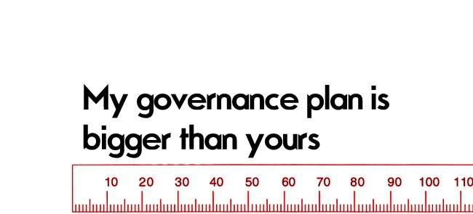
Fine tuning search – Governance
© @Naoko_Strega
© @Naoko_Strega

Slide 19
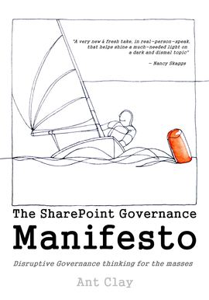

Fine tuning search – Governance
The act of governance will improve search.
What do we mean by governance
  E.g. Folders – The deeper an item is, the LOWER it’s ranking
  Metadata tagging – Improves the search experience
  Social tagging – “I Like it” improves rank
Ruven Gotz’s book (Click on book for Amazon link)
Ant Clay’s book (click on book for leanpub link)
Notes:
Here specifically we’re talking about the SharePoint Information governance, e.g. control of lists and libraries, tagging
Riven Gotz has a great book on SharePoint Governance, well worth a read.
Kindle and Paperback version available on Amazon.
Ant Clay also has a more Disruptive view on Governance that is still in the process of being written using LeanPub. He’s here today and will happily talk about governance etc if you didn’t see him in his session earlier)

Slide 20
Fine tuning search – Scopes
User experience tuning
Can be configured at a Farm or Site Collection Level in 2010
Avoid having too many scopes
Level of control greatly enhanced in SP2013
  Scopes have disappeared, we now have Result Sources
  Controllable down to the web level
Notes:
Scopes can be used to tune the user experience
You should have a good reason for using them! E.g. Restricting search to Company Policy Documents, search driven applications
If scopes are required, they should be included in your Information Governance policy and reviewed.
Example.. Is a document scope needed? Search on Santa.. Result type modifiers
Limits - 200 Site Scopes and 200 Shared Scopes, adding these to the display group would affect browser latency.
In SP2013, scopes have gone and have been replaced with Result Sources, Scopes on steroids!

Slide 21

Fine tuning search – Best Bets
Triggered by keywords
Configured at a Site Collection Level (Usually the Search SC)
Can be Scheduled!
Can be configured by PowerShell
Supported limit is 200 Keywords per site collection.
Notes:
Keywords
200 per site collection
Supported
The recommended limit can be exceeded up to the maximum (ASP.NET-imposed) limit of 5,000 per site collection given five Best Bets per keyword. If you exceed this limit, display of keywords on the site administration user interface will degrade. The ASP.NET-imposed limit can be modified by editing the Web.Config and Client.config files (MaxItemsInObjectGraph).

Slide 22
Fine tuning search – Best Bets
Triggered by keywords
Configured at a Site Collection Level (Usually the Search SC)
Can be Scheduled!
Can be configured by PowerShell
DEMO
Notes:
When people search for Dr Who (Or The Doctor), we want to show them the www.bbc.co.uk/drwho web site
This should be a published link, with an owner and end at the end of the year
Search Site Collection, Site Settings/Search Keywords
And in Powershell too
Tardis.. Tardis.wikia.com… The official Dr Who Wikipedia website

Slide 23

Fine tuning search – Thesaurus
Best
Bet!
Notes:
Sometimes the Best bet is too intrusive for what we want to achieve or too limiting if we need more keywords.

Slide 24

Fine tuning search – Thesaurus
John Smith
Time’s Champion
The Doctor
Theta Sigma
Johann Schmidt
The Dark Lord
The Threefold Man
Ka Faraq Gatri
Sir Doctor of Tardis
The Sandman
Maximus Pettulian
Dr Who
Notes:
In this instance, a user searching for one term, may be better served by a different term.
The thesaurus allows us to add those terms into the search without the user being aware.

Slide 25
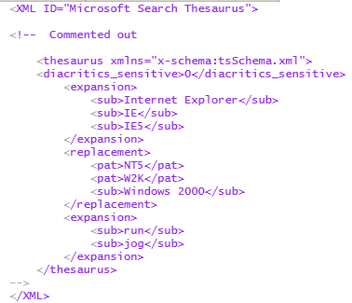
Fine tuning search - Thesaurus
(SP2010) Thesaurus file per language
Expansions – Search for additional terms, as well as the original query
Replacements – Search for different terms, ignoring the original query
Notes:
Full details at http://technet.microsoft.com/en-us/library/dd361734(v=office.14).aspx
The Thesaurus files can only be manipulated in the file system..
http://technet.microsoft.com/en-us/library/dd361734(v=office.14).aspx
Note, Still available in SP2013, although Replacement sets are no longer supported. Entries are now added by CSV rather than individual TSxxx.xml files
You may need to use a custom dictionary if the wordbreaker might upset the synonym. E.g. AT&T
Performance limit of 10000 items in a thesaurus file.

Slide 26

Fine tuning search - Thesaurus
(SP2013) Single CSV file including all Languages
All entries are Expansions.
Replacement sets have been removed
$searchApp = Get-SPEnterpriseSearchServiceApplication [GUID]
Import-SPEnterpriseSearchThesaurus -SearchApplication $searchApp -Filename <Path>
Notes:
Full details at http://technet.microsoft.com/en-us/library/jj219579.aspx
Now only ONE Thesaurus per farm.

Slide 27
Fine tuning search – Thesaurus
2010
DEMO
Dr Who

Slide 28

Fine tuning search – People Search
Phonetic & Nickname search does NOT work out of the box for en-GB installations
Blog post: http://tinyurl.com/Nicknamefix
Notes:
Out of the box, SharePoint ships with some 14391 different phonetic name spellings for American names, however these are all mapped to en-US (Locale ID 1033)
This means that Phonetic and nickname search does NOT work with en-GB locales.
Blog post on how to fix.. http://tinyurl.com/Nicknamefix

Slide 29



Fine tuning search – People Search
Searching for derivatives of Michael.
DEMO
Notes:
Quick people search demo, searching for Mike and Michael, plus the nickname Mikey
Use SQL Management studio to show the entries. (Talk about blog post fixing this en masse -
Using Powershell to add new entries.
Redoing the search to show working

Slide 30
Fine tuning search – Performance
Monitoring Reports
  Query Latency
    Overall Query Latency
    SharePoint Backend Query Latency
    Query Latency Trends
  Crawl Latency Report
    Crawl rate per content source
    Crawl rate per type
Notes:
Search Admin Reports - http://technet.microsoft.com/en-us/library/ee808861(office.14).aspx
Query Latency reports
Overall Query Latency, shows Backend Query, plus Rendering processing etc
Backend – Shows the time spent in the index and properties store
Latency Trends – Disabled by default, shows Query trends alongside Crawl rate to help correlate issues. (Suggest a separate usage database to reduce the “Observer Effect”)
These reports should help you steer your efforts in reducing search bottlenecks
e.g. Reduce Query latency with additional index partitions or reduce throughput with the use of Active mirrors.
You MUST pay attention to capacity planning though!

Slide 31
Questions?
Notes:
A couple of slides left, Any questions before the end?

Slide 32

Fine Tuning Search – Call to Action
Take a look at the analytics.
Talk to your user base about their search experience
Don’t just fire and forget!
Notes:
Make sure you have analytics turned on.. Use them
Talk to your users or try and gain an understanding of their issues
Don’t just install Search and ignore it!

Slide 33
Reference Articles
The Probabilistic Relevance Framework: BM25 & Beyond
http://www.soi.city.ac.uk/~ser/papers/foundations_bm25_review.pdf
Notes:
This is the relevance framework that SharePoint is rumoured to use.

Slide 34
Reference Books:
Apress: Pro SharePoint Search 2010 (Noble, Piddocke,Bakmand-Mikalski)
  Book – http://amzn.to/tDobqK
  Kindle - http://amzn.to/uvTvyx
Apress: Practical SharePoint 2010 Information Architecture (Ruven Gotz)
  Book – http://amzn.to/TGWKmS
  Kindle – http://amzn.to/TGWGDI
The SharePoint Governance Manifesto (Ant Clay)
  http://tinyurl.com/SPManifesto

Slide 35
Thank you!
See you at SharePint!
Blog: www.myfatblog.co.uk
Twitter: @cimares
Notes:
See you at SharePint

